Slide 1
Data Structure (CSE 2101)
Instructor: Hasnain Heickal
Department of CSE, University of Dhaka

Slide 2
Heap
Instructor: Hasnain Heickal
Department of CSE, University of Dhaka

Slide 3
Complete Binary Tree
  A complete binary tree is a binary tree in which every level, except possibly the last, is completely filled, and all nodes are as far left as possible.

Slide 4
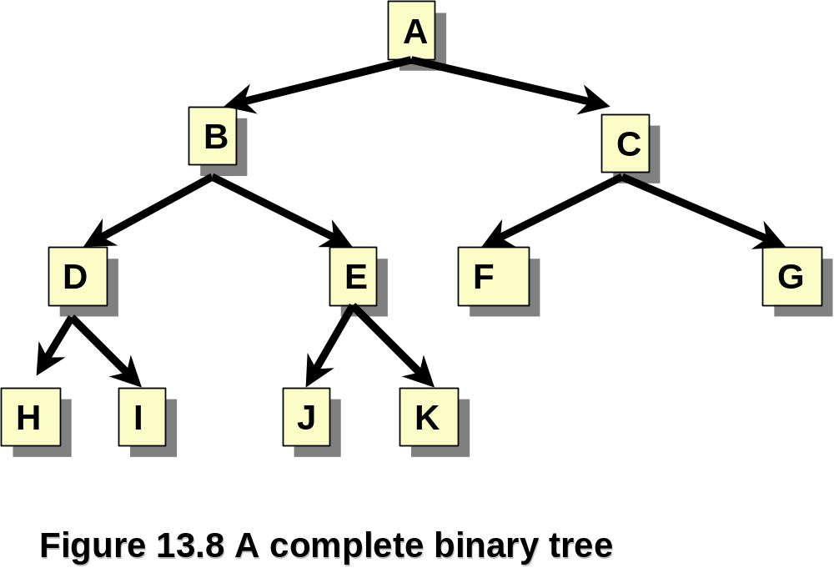
Complete Binary Trees - Example

Slide 5
Heap
Definition in Data Structure
  Heap: A special form of complete binary tree that key value of each node is no smaller (or larger) than the key value of its children (if any).

Slide 6
Variation of Heap
Binary Heap [Min Heap/Max Heap]
Binomial Heap
Fibonacci Heap
Pairing Heap
Treap
Beap

Slide 7
Max Heap
Root node has the largest key.
A max tree is a tree in which
    the key value in each node is no smaller than the key values in its children.
A max heap is a complete binary tree that is also a max tree.

Slide 8
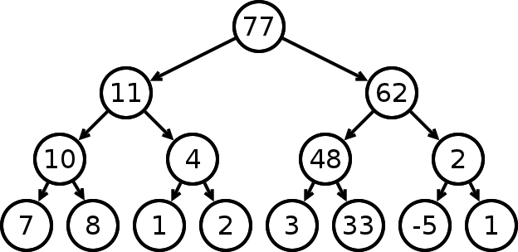
Max Heap

Slide 9
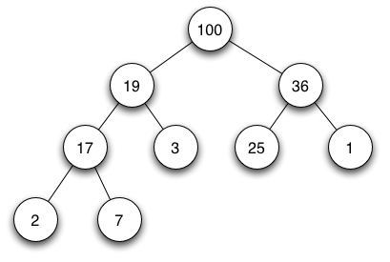
Max Heap

Slide 10
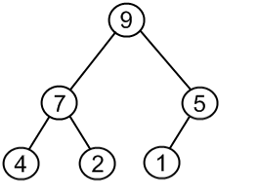
Max Heap

Slide 11
Min Heap
Root node has the smallest key.
A mintree is a tree in which
    the key value in each node is no greater than the key values in its children.
A min heap is a complete binary tree that is also a min tree.

Slide 12
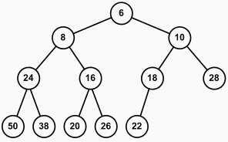
Min Heap

Slide 13
Array Representation of Heap
  Heap in data structure is a complete binary tree! (Nice representation in Array)
  Heap in C program environment is an array of memory. No cell unused!
  Stored using array in C
  index 1 2 3 4 5 6 7 8 9 10
  value 77 61 59 48 19 11 26 15 1 5
[1]
77
[2]
61
[3]
59
48
19
11
26
[4]
[5]
[6]
[7]
15
1
5
[8]
[9]
[10]

Slide 14

Heap Operations
Operations
  Creation of an empty heap
  Insertion of a new element into the heap
  Deletion of the largest (smallest) element from the heap
Heap is complete binary tree. So the complexity of inserting any node or deleting the root node from Heap is O(height) = O( ).

Slide 15
Heap Operations in Array
Given the index i of a node
  Parent(i)
    return i/2
  LeftChild(i)
    return 2i
  RightChild(i)
    Return 2i+1

Slide 16
Example of Insertion to Max Heap
www.visualgo.net

Slide 17
Insertion into a Max Heap
Add the element to the bottom level of the heap.
Compare the added element with its parent; if they are in the correct order, stop.
If not, swap the element with its parent and return to step 2.
Complexity? O(logN)

Slide 18
Example of Deletion from Max Heap
Only extractMax is possible in heap.
Deletes the root
www.visualgo.net

Slide 19
Deletion from a Max Heap
Replace the root of the heap with the last element on the last level.
Compare the new root with its children; if they are in the correct order, stop.
If not, swap the element with one of its children and return to the previous step.
Complexity? O(logN)

Slide 20
Deletion from a Max Heap
One of its children means what??
  Larger child in a max-heap.
  Smaller child in a min-heap.

Slide 21
Application of Heap: Heap Sort
Input : N numbers
Insert each number into Min-Heap
  Each insertion takes O(logN)
  N insertion take O(NlogN)
ExtractMin N times
  Each extraction takes O(logN)
  N extraction take O(NlogN)
Total complexity O(NlogN) +O(NlogN)
O(NlogN)

Slide 22
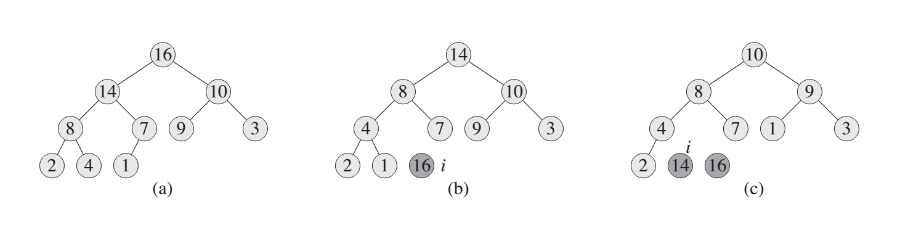
Heap Sort Step 1- 3

Slide 23
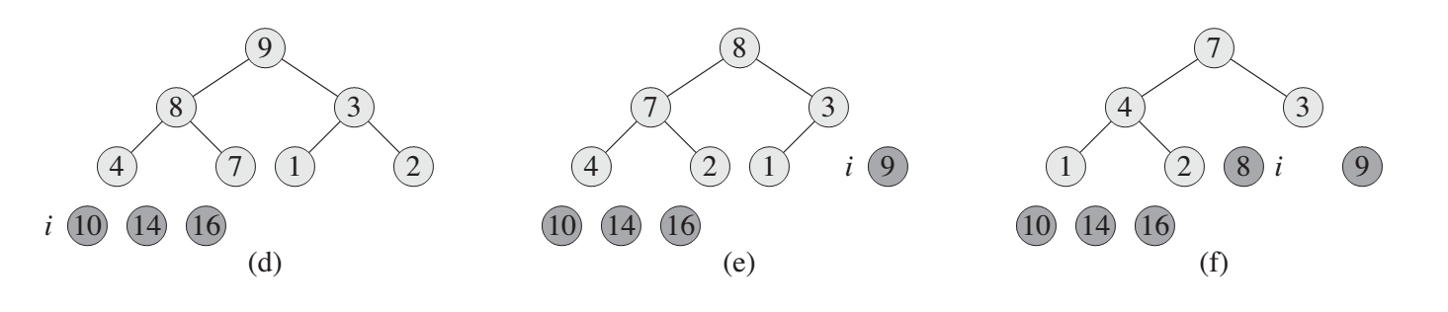
Heap Sort Step 4 - 6

Slide 24
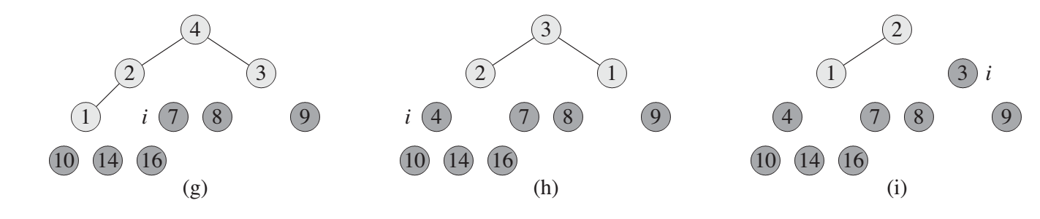
Heap Sort Step 7 - 9

Slide 25
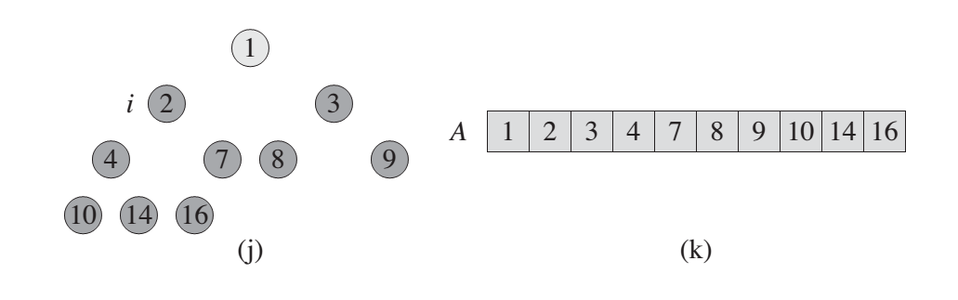
Heap Sort Step 10 - 11

Slide 26
Heap Sort
  In place.
  Not Stable.
  No quadratic worst-case scenarios.

Slide 27
Study Materials
CLRS - Chapter 6

Slide 28
Application of Heap: Priority Queue
From Wiki ....
“In computer science, a priority queue is an abstract data type which is like a regular queue or stack data structure, but where additionally each element has a "priority" associated with it. In a priority queue, an element with high priority is served before an element with low priority. If two elements have the same priority, they are served according to their order in the queue.

Slide 29
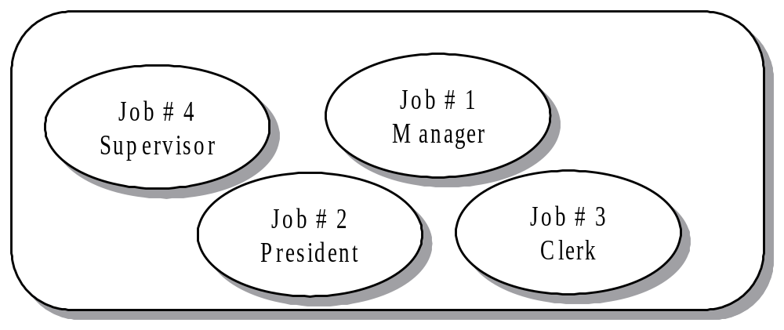
Priority Queue
A Special form of queue from which items are removed according to their designated priority/weight and not the order in which they entered.
Items entered the queue in sequential order but will be removed in the order #2, #1, #4, #3.

Slide 30
Priority Queue
A priority queue is a container in which access or deletion is of the highest-priority item, according to some way of assigning priorities to items.

Slide 31
Priority Queue
Suppose a hospital emergency room has the following four patients, with name, priority, and injury:
Matt 20 sprained ankle
Andrew 45 broken leg
Samira 20 active labor
Kerem 83 heart attack
IN WHAT ORDER SHOULD THE PATIENTS BE TREATED?

Slide 32
Priority Queue Simulation
1. Push (A, 50)
2. Push(B, 100)
3. Push(C, 30)
4. Push(A, 100)
5. Pop?
6. Push(C,110)
7. Pop?
8. Push(D,60)
9. Pop?
10. Pop?
11. Pop?
12. Pop?

Slide 33
Priority Queue ADT
Data
  Stores elements (Value, Priority) pair
Methods
  Push/Enqueue
    Pushes a new item (V,P)
  Pop/Dequeue
    Pops the item currently in the queue with highest priority/weight.
  Top/Peek/Front
    Examines the item that will be popped next.

Slide 34
Evaluating implementations
When we choose a data structure, it is important to look at usage patterns
  If we load an array once and do thousands of searches on it, we want to make searching fast—so we would probably sort the array
  If we load a huge array and expect to do only a few searches, we probably don’t want to spend time sorting the array
For almost all uses of a queue (including a priority queue), we eventually pop everything that we push
Hence, when we analyze a priority queue, neither “add” nor “remove” is more important—we need to look at the timing for “pop + push”

Slide 35
Priority Queue Implementation (Array)
Use Array of Structure.
struct element{
int value;
int priority;
};
struct priorityQueue{
struct element data[100];
int size;
void push(element x){...}
element pop(){...}
}
priorityQueue PQ;

Slide 36
Priority Queue Implementation (Unsorted Array)
Push : Pushes element at end of queue
  PQ.data[PQ.size] = currentData;
  PQ.size++;
  Complexity : O(1)
Pop : Searches for item having maximum priority.
  for(i = 0; i < PQ.size; i ++ )
  ... ... ...
  Complexity : O(n) !!
  Adjust the new array to fill empty slots overhead.

Slide 37
Priority Queue Implementation (Sorted Array)
Push : Pushes element at correct position of queue
  Complexity : O(n) !!
Pop : Pop the first element.
  Complexity : O(1)

Slide 38
Array implementations
A priority queue could be implemented as an unsorted array (with a count of elements)
  Adding an element would take O(1) time
  Removing an element would take O(n) time
  Hence, adding and removing an element takes O(n) time
  This is an inefficient representation
A priority queue could be implemented as a sorted array (with a count of elements)
  Adding an element would take O(n) time
  Removing an element would take O(1) time
  Hence, adding and removing an element takes O(n) time
  Again, this is inefficient

Slide 39
Linked list implementations
A priority queue could be implemented as an unsorted linked list
  Adding an element would take O(1) time
  Removing an element would take O(n) time
A priority queue could be implemented as a sorted linked list
  Adding an element would take O(n) time
  Removing an element would take O(1) time
As with array representations, adding and removing an element takes O(n) time
  Again, these are inefficient implementations

Slide 40
Priority Queue Implementation
Worst Case:
  Linear time (O(n)) for each push/pop.
Is there a better solution?
  Yes!
  Max Heap/Min Heap.

Slide 41
Heap implementation
A priority queue can be implemented as a heap
In order to do this, we have to define the heap property
  For a priority queue, we will define a node to have the heap property if it is as least as small (or large) as its children (since we are using smaller numbers to represent higher priorities)
12
3
8
3
8
12

Slide 42
Sorting with a Priority Queue (Same as heap sort)
We can use a priority queue to sort a set of comparable elements
  Insert the elements one by one with a series of push(e) operations
  Remove the elements in sorted order with a series of pop() operations
The running time of this sorting method depends on the priority queue implementation

Slide 43
Priority Queue Applications
Scheduling
Data compression (Huffman Coding)
JPEG (joint photographic experts group) encoding.
Implementing Shortest Path algorithm in Graph Theory (Dijkstra’s algorithm)
Stock Market
Auctions

Slide 44
Study Materials
CLRS - Chapter 6 :: 6.5
https://sites.google.com/site/smilitude/stl -
  প্রায়োরিটি কিউ
  < (Less than) Operator Overloading

